Slide 1
Point-to-Point - IV
Lecture 7
January 29, 2024

Slide 2
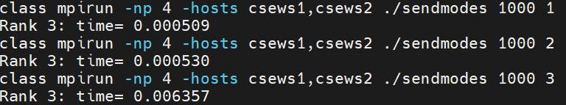
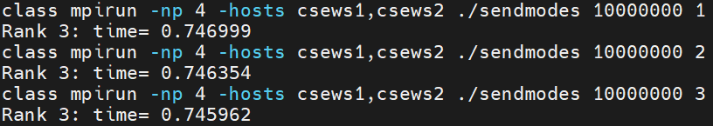
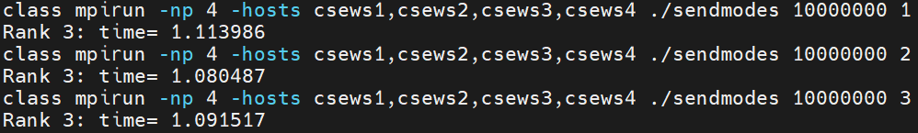
Performance of Send Modes
MPI_Send
MPI_Bsend
MPI_Ssend
Rendezvous
Forced buffering
Forced synchronization

Slide 3
Example

Slide 4
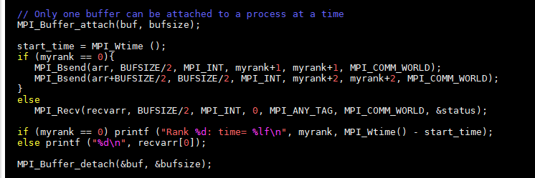
MPI_Bsend
The size given should be the sum of the sizes of all outstanding Bsends that you intend to have, plus 'MPI_BSEND_OVERHEAD' for each Bsend that you do.

Slide 5
Nearest Neighbor (NN) Exchange
0
P-1

Slide 6
Nearest Neighbor Pseudocode
Tags?
Performance?
Option 1: Schedule right sends followed by left sends
if (myrank < P-1)
{
// Send/recv right neighbor
MPI_Send (data, myArraySize, MPI_DOUBLE, myrank+1, myrank+1, MPI_COMM_WORLD);
MPI_Recv (recvbuf, myArraySize, MPI_DOUBLE, myrank+1, myrank, MPI_COMM_WORLD, &status);
}
if (myrank > 0)
{
// Send/recv left neighbor
MPI_Recv (recvbuf, myArraySize, MPI_DOUBLE, myrank-1, myrank, MPI_COMM_WORLD, &status);
MPI_Send (data, myArraySize, MPI_DOUBLE, myrank-1, myrank-1, MPI_COMM_WORLD);
}
?
?
?
?

Slide 7
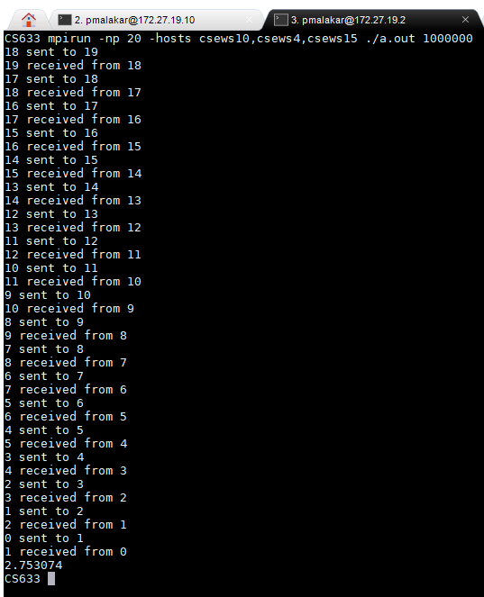


Output

Slide 8
Nearest Neighbor Pseudocode
Option 2: Schedule odd and even ranks alternately
if (myrank % 2 == 0 && myrank < P-1)
{
// Send/recv right neighbour from even ranks
MPI_Send (data, myArraySize, MPI_DOUBLE, myrank+1, myrank+1, MPI_COMM_WORLD);
MPI_Recv (recvbuf, myArraySize, MPI_DOUBLE, myrank+1, myrank, MPI_COMM_WORLD, &status);
}
else if (myrank % 2 != 0 && myrank > 0)
{
// Send/recv left neighbor
MPI_Recv (recvbuf, myArraySize, MPI_DOUBLE, myrank-1, myrank, MPI_COMM_WORLD, &status);
MPI_Send (data, myArraySize, MPI_DOUBLE, myrank-1, myrank-1, MPI_COMM_WORLD);
}

Slide 9
Nearest Neighbor Pseudocode
if (myrank % 2 != 0 && myrank < P-1)
{
// Send/recv right neighbor from odd ranks
MPI_Send (data, myArraySize, MPI_DOUBLE, myrank+1, myrank+1, MPI_COMM_WORLD);
MPI_Recv (recvbuf, myArraySize, MPI_DOUBLE, myrank+1, myrank, MPI_COMM_WORLD, &status);
}
else if (myrank % 2 == 0 && myrank > 0)
{
// Send/recv left neighbor
MPI_Recv (recvbuf, myArraySize, MPI_DOUBLE, myrank-1, myrank, MPI_COMM_WORLD, &status);
MPI_Send (data, myArraySize, MPI_DOUBLE, myrank-1, myrank-1, MPI_COMM_WORLD);
}

Slide 10
Same Host (Option 1 vs. 2)
for i in `seq 1 5` ; do mpirun -np 4 ./nn-1 1000000 ; done
0.006751
0.006896
0.006518
0.006310
0.006356
for i in `seq 1 5` ; do mpirun -np 4 ./nn-2 1000000 ; done
0.006183
0.017730
0.006718
0.006862
0.006701

Slide 11
Two Hosts (Option 1 vs. 2)
for i in `seq 1 5` ; do mpirun -np 4 -hosts csews1,csews10 ./nn-1 1000000 ; done
0.450281
0.426031
0.419316
0.445110
0.416786
or i in `seq 1 5` ; do mpirun -np 4 -hosts csews1,csews10 ./nn-2 1000000 ; done
0.405743
0.423926
0.410813
0.420823
0.430066

Slide 12
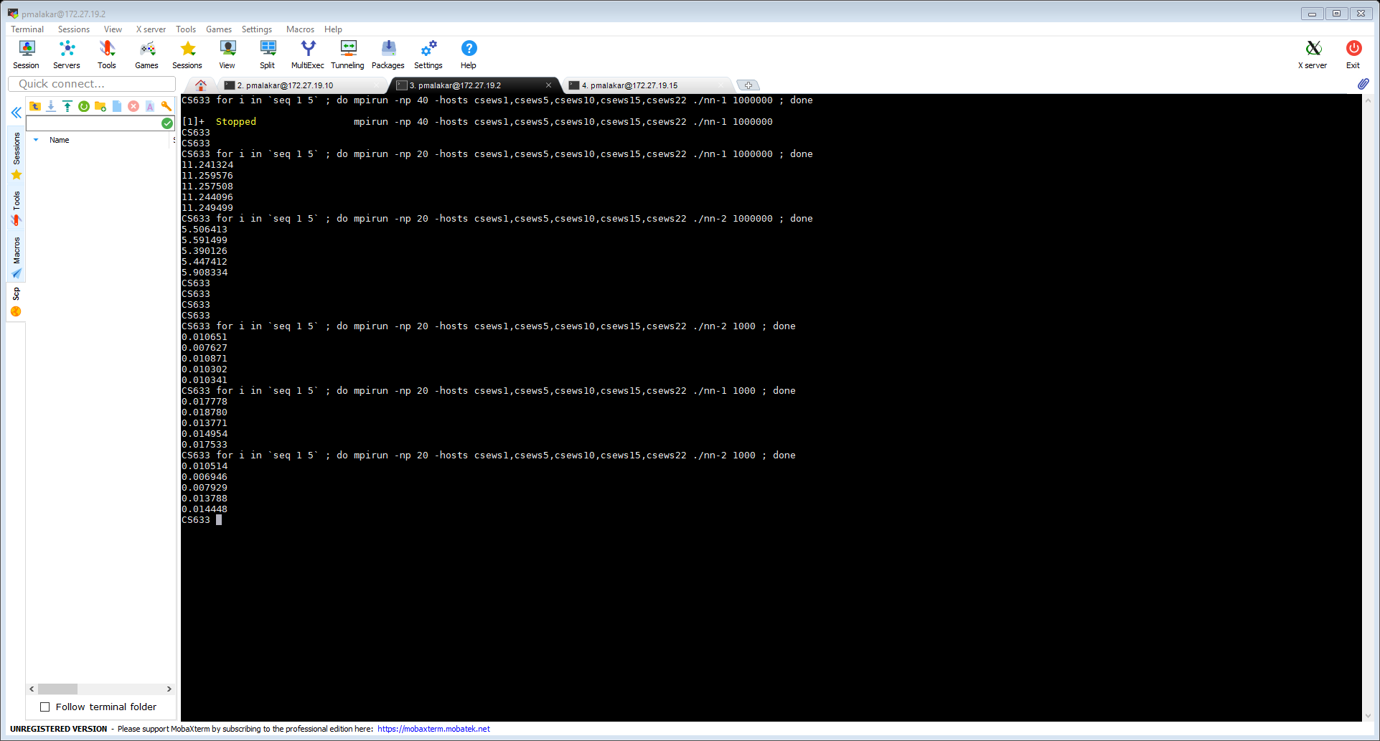
Timing Option 1 vs. Option 2

Slide 13
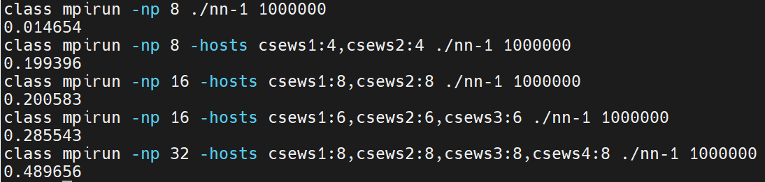
Timing NN

Slide 14
P2P Blocking – Performance Bottleneck
MPI_Send (buf, count, datatype, dest, tag, comm)
MPI_Recv (buf, count, datatype, source, tag, comm, status)
0
1
MPI_Send (1)
Safe but may delay sender
MPI_Recv (0)
Notes:
Send blocks until corr. Recv is posted for large messages

Slide 15
Computation Communication Overlap
0
1
compute
Send
compute
Time
compute
Recv
Wait
compute
compute

Slide 16
Non-blocking Point-to-Point
MPI_Isend (buf, count, datatype, dest, tag, comm, request)
MPI_Irecv (buf, count, datatype, source, tag, comm, request)
MPI_Wait (request, status)
MPI_Waitall (count, request, status)

Slide 17
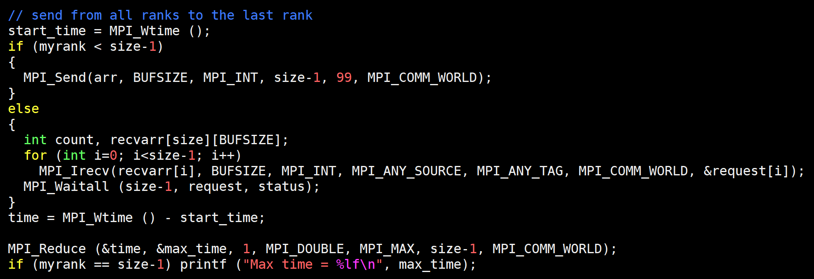
Many-to-one Non-blocking P2P

Slide 18
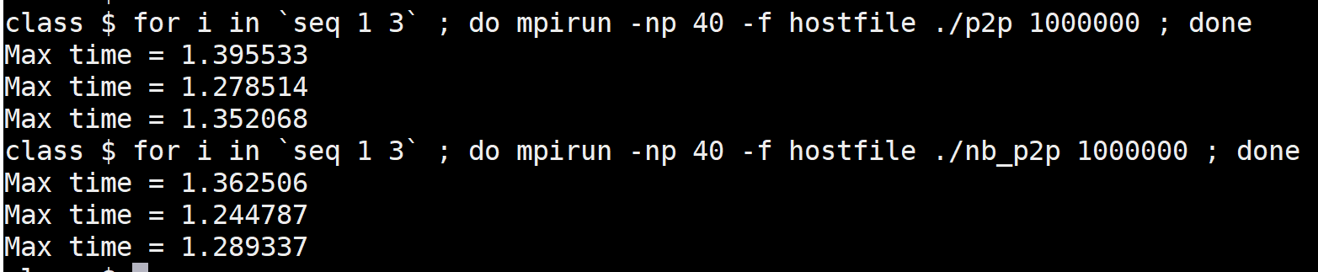
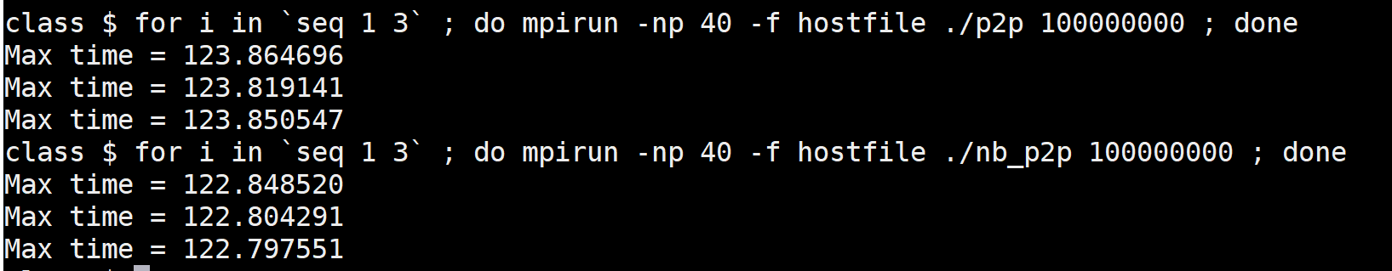
Output

Slide 19
Non-blocking Performance
Standard does not require overlapping communication and computation
Implementation may use a thread to move data in parallel
Implementation can delay the initiation of data transfer until “Wait”
MPI_Test – non-blocking, tests completion, starts progress
MPIR_CVAR_ASYNC_PROGRESS (MPICH)

Slide 20
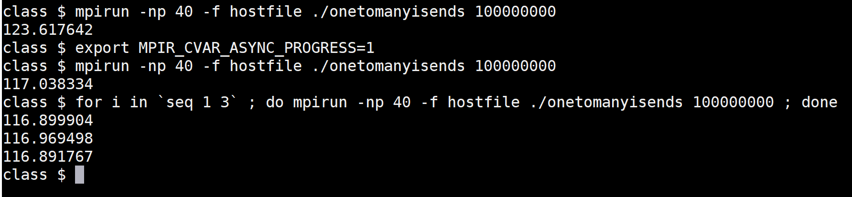
Asynchronous Communication Progress

Slide 21
Non-blocking Point-to-Point Safety
MPI_Isend (buf, count, datatype, dest, tag, comm, request)
MPI_Irecv (buf, count, datatype, source, tag, comm, request)
MPI_Wait (request, status)
0
1
MPI_Isend
MPI_Isend
Safe
MPI_Recv
MPI_Recv

Slide 22
Homework: NN 1D using Non-blocking
0
P-1

Slide 23
Process Mapping/Allocation
0
1
10
11
0
1
2
3
4
7
8
11

Slide 24
Attributes of Interconnects
Topology
Diameter
Cost
Anything else?

Slide 25
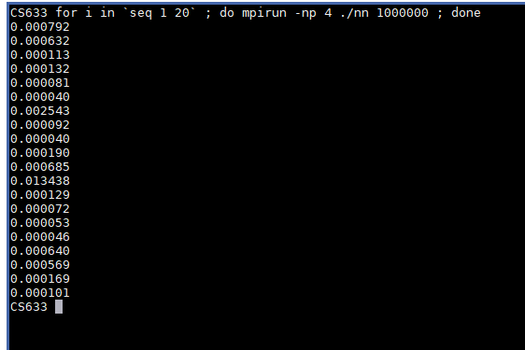
Output
Outlier

Slide 26
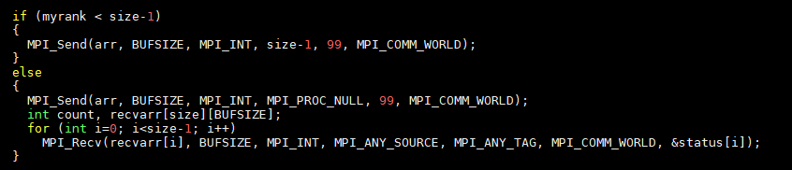
MPI_PROC_NULL
Specify a dummy source/destination

Slide 27
MPI_PROC_NULL

Slide 28
MPI_PROBE
Blocking test for a message
int MPI_Probe (
int source,
int tag,
MPI_Comm comm,
MPI_Status *status)

Slide 29
Semantics of P2P
Order
Messages are non-overtaking
Any two communications by a process are ordered
Progress
Fairness
No guarantee
Resource limitations
Errors may occur when lack of resources prevent the execution of an MPI call

Slide 30
Message Progress Semantics
IF (rank .EQ. 0) THEN
MPI_BSEND (buf1, count, MPI_INT, 1, tag1, comm)
MPI_SSEND (buf2, count, MPI_INT, 1, tag2, comm)
ELSE IF (rank .EQ. 1) THEN
MPI_RECV (buf1, count, MPI_INT, 0, tag2, comm, status)
MPI_RECV (buf2, count, MPI_INT, 0, tag1, comm, status)
END IF
Process 1 receives messages in reverse order

Slide 31
Message Ordering Semantics
IF (rank .EQ. 0) THEN
MPI_BSEND (buf1, count, MPI_INT, 1, tag, comm)
MPI_BSEND (buf2, count, MPI_INT, 1, tag, comm)
ELSE IF (rank .EQ. 1) THEN
MPI_RECV (buf1, count, MPI_INT, 0, MPI_ANY_TAG, comm, status)
MPI_RECV (buf2, count, MPI_INT, 0, tag, comm, status)
END IF
Match must be ensured by the implementation (to avoid non-determinism)
Notes:
If a receiver posts two receives in succession, and both match the same message, then the second receive operation cannot be satisfied by this message, if the first one is still pending. (page 94 of https://www.mpi-forum.org/docs/mpi-4.0/mpi40-report.pdf)

Slide 32
Output
Outlier

Slide 33
MPI_PROC_NULL
Specify a dummy source/destination

Slide 34
MPI_PROC_NULL

Slide 35
MPI_Sendrecv
MPI_SENDRECV (sendbuf, sendcount, sendtype, dest, sendtag, recvbuf, recvcount, recvtype, source, recvtag, comm, status)
Blocking send and receive
Same communicator
Send and receive buffers must be disjoint

Slide 36
NN using MPI_Sendrecv
//Even right send and odd left send
if (myrank % 2 == 0 && myrank < P-1)
MPI_Sendrecv ( );
else if (myrank % 2 != 0 && myrank > 0)
MPI_Sendrecv ( );
//Even left send and odd right send
if (myrank % 2 != 0 && myrank < P-1)
MPI_Sendrecv ( );
else if (myrank % 2 == 0 && myrank > 0)
MPI_Sendrecv ( );

Slide 37
Homework
NN using MPI_PROC_NULL
NN using MPI_Sendrecv

Slide 38
Send 2D Array

Slide 39
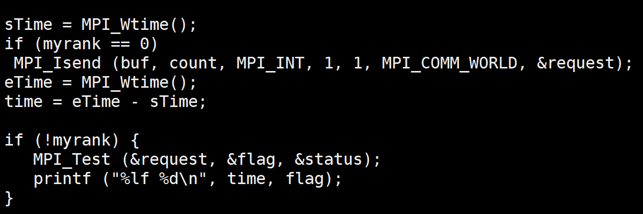
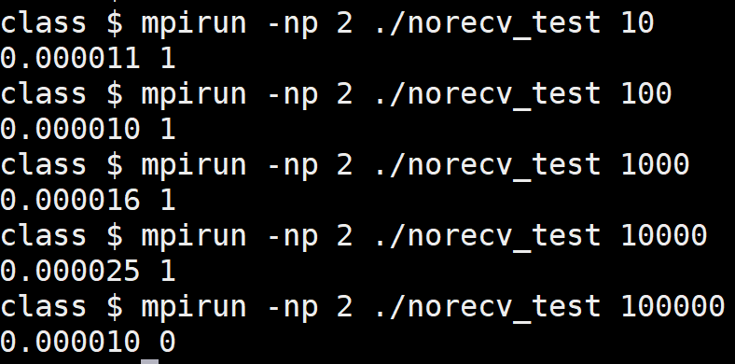
MPI_Test

Slide 40
Message Ordering
IF (rank.EQ.0) THEN
MPI_ISEND (buf1, count, MPI_INT, 1, 0, comm, req1)
MPI_ISEND (buf2, count, MPI_INT, 1, 0, comm, req2)
ELSE IF (rank.EQ.1) THEN
MPI_IRECV (buf1, count, MPI_INT, 0, MPI_ANY_TAG, comm, req1)
MPI_IRECV (buf2, count, MPI_INT, 0, 0, comm, req2)
END IF
MPI_WAIT (req1, status1)
MPI_WAIT (req2, status2)

Slide 41
MPI_Pack
int MPI_Pack (const void *inbuf, int incount, MPI_Datatype datatype, void *outbuf, int outsize, int *position, MPI_Comm comm)
MPI_Pack (&num1, 1, MPI_INT, buffer, 1000, &position, MPI_COMM_WORLD);
MPI_Pack (&num2, 1, MPI_INT, buffer, 1000, &position, MPI_COMM_WORLD);
MPI_Send (buffer, position, MPI_PACKED, dest, 0, MPI_COMM_WORLD);
MPI_Recv (recvbuf, 2, MPI_INT, source, 0, MPI_COMM_WORLD)

Slide 42
MPI_Unpack
int MPI_Unpack (const void *inbuf, int insize, int *position, void *outbuf, int outcount, MPI_Datatype datatype, MPI_Comm comm)
for (int r=0; r<6; r++)
MPI_Pack (&array[r][5], 1, MPI_INT, buffer, 1000, &position, MPI_COMM_WORLD);
MPI_Send (buffer, position, MPI_PACKED, dest, 0, MPI_COMM_WORLD);
MPI_Recv (recvBuf, count, MPI_PACKED, source, 0, MPI_COMM_WORLD, &status);
for (int r=0; r<6; r++)
MPI_Unpack (recvBuf, 1000, &position, &recvArr[r][0], 1, MPI_INT, MPI_COMM_WORLD);

Slide 43
MPI_PACK Example
source
dest
for (int r=0; r<6; r++)
MPI_Pack (&array[r][5], 1, MPI_INT, buffer, 1000, &position, MPI_COMM_WORLD);
MPI_Send (buffer, position, MPI_PACKED, dest, 0, MPI_COMM_WORLD);
MPI_Recv (recvColumn, count, MPI_INT, source, 0, MPI_COMM_WORLD, &status);

Slide 44
Communication Subsystem
Communication using sockets (one of the options)
MPI handles communications, progress etc.
Communication channels determine performance
Shared-memory queue for intranode messaging
  Per-process send/recv queue
Send queue
Recv queue
Reference: Design and Evaluation of Nemesis, a Scalable, Low-Latency, Message-Passing Communication Subsystem by Buntinas et al.

Slide 45
Communication Channels
Sockets for network I/O (wire protocol in PMI)
PMI is responsible for creating/initializing/cleanup
MPI handles communications, progress etc.
Reading (optional): Design and Evaluation of Nemesis, a Scalable, Low-Latency, Message-Passing Communication Subsystem
Notes:
The communication mechanisms in MPICH are called "devices". MPICH supports ch3 (default) and ch4 (experimental), as well as many third-party devices that are released and maintained by other institutes. ************************************* ch3 device ********** The ch3 device contains different internal communication options called "channels". We currently support nemesis (default) and sock channels. nemesis channel --------------- Nemesis provides communication using different networks (tcp, mx) as well as various shared-memory optimizations. To configure MPICH with nemesis, you can use the following configure option:
In the {\tt CH3\_TCP} device used on Linux clusters, TCP isused to support MPI communication. Connections between processes areestablished by the normal socket {\tt connect}/{\tt accept} mechanism.For this to work, before the first {\tt MPI\_SEND} from one process toanother, one process must have acquired a port from the operating systemand be listening on it with the normal {\tt socket}/{\tt bind}/{\tt listen}sequence. The other process, typically on a separate host, will executethe corresponding {\tt socket}/{\tt connect} sequence, at which time thefirst process will issue an {\tt accept}, establishing the TCPconnection.

